Slide 1
Introduction to histology
Dr Hemed El-busaidy
BSc (Anat), MBCHB, Mmed (Urology)-UON

Slide 2
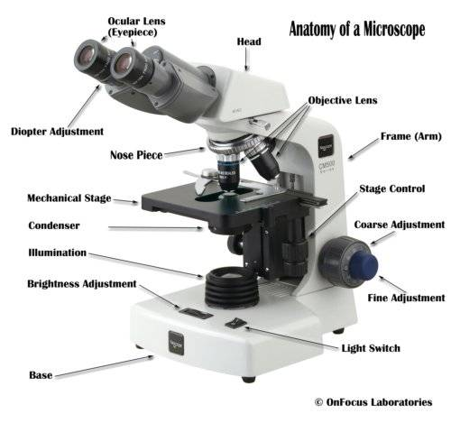

Slide 3
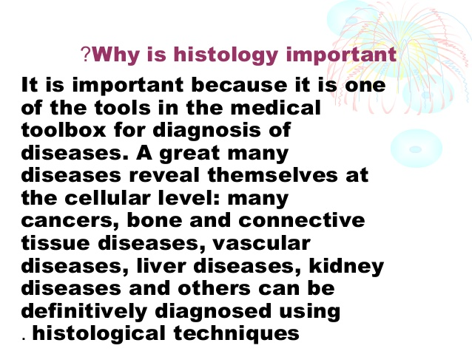

Slide 4
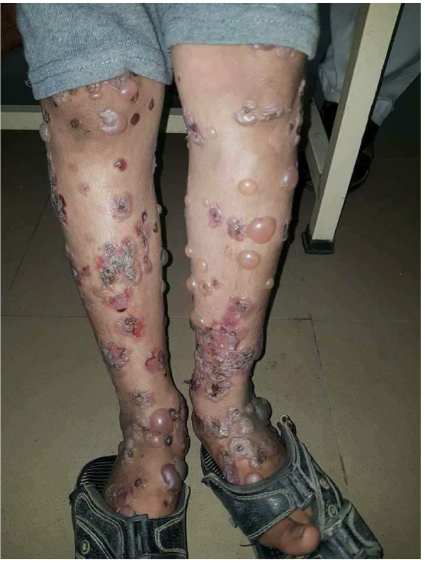
Bullous pemphigoid

Slide 5
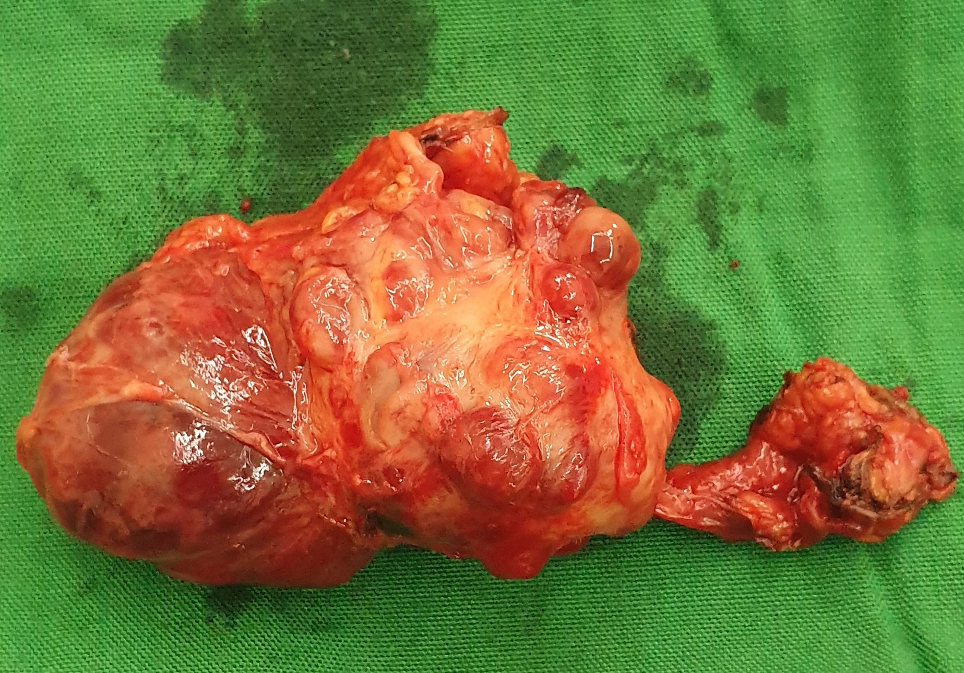
Renal tumor

Slide 6
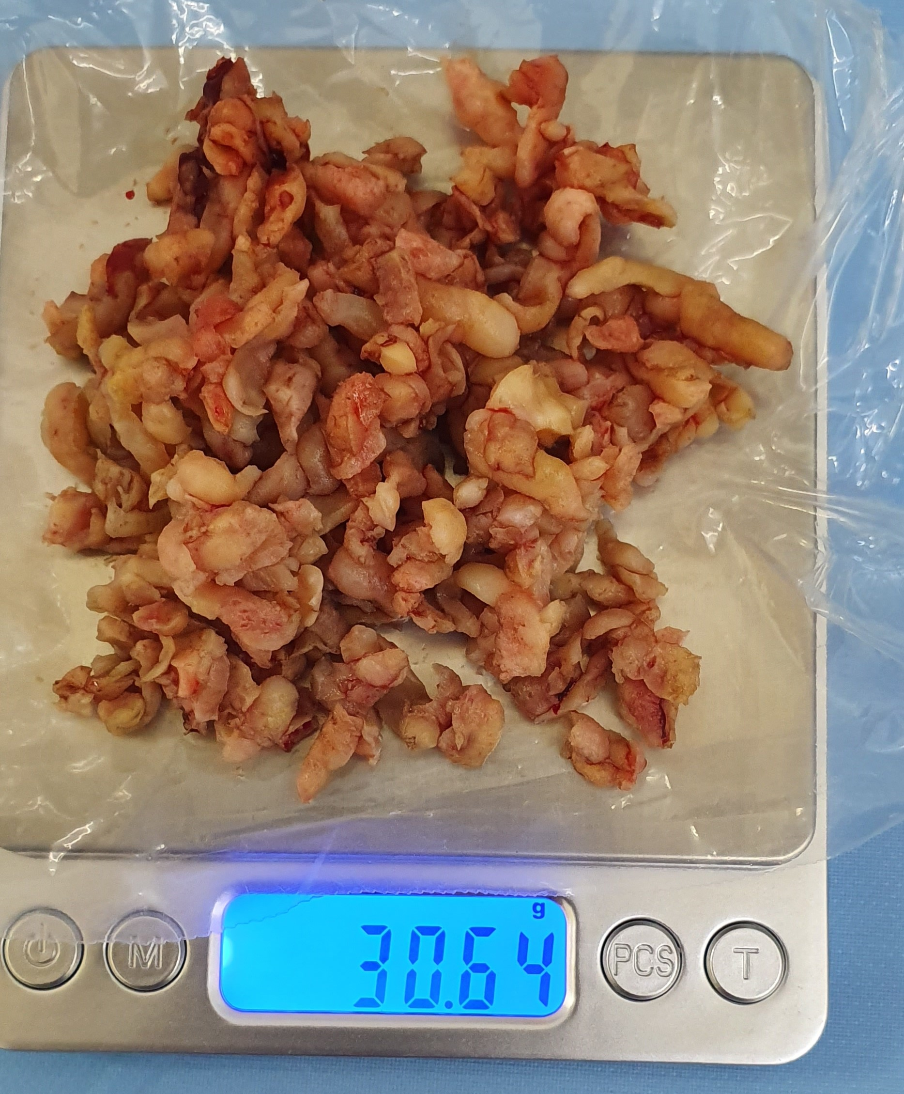
Prostate chips

Slide 7
Practical
Histology of skin
Histology of muscle

